Slide 1
Trait biogeography paper
Figure 1

Slide 2
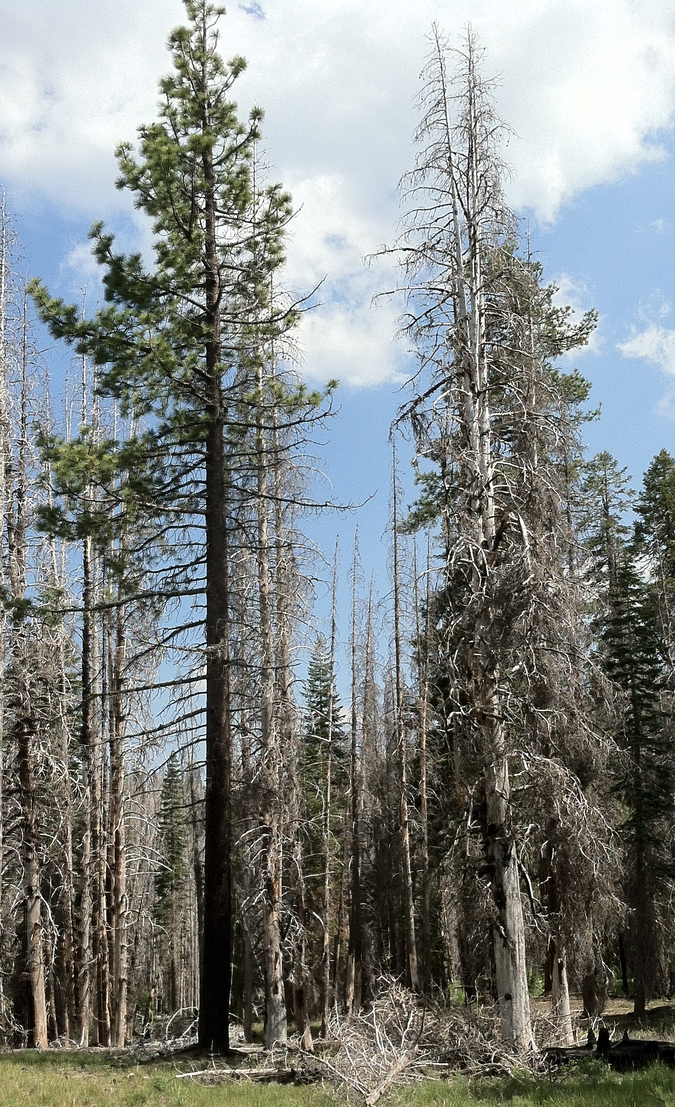
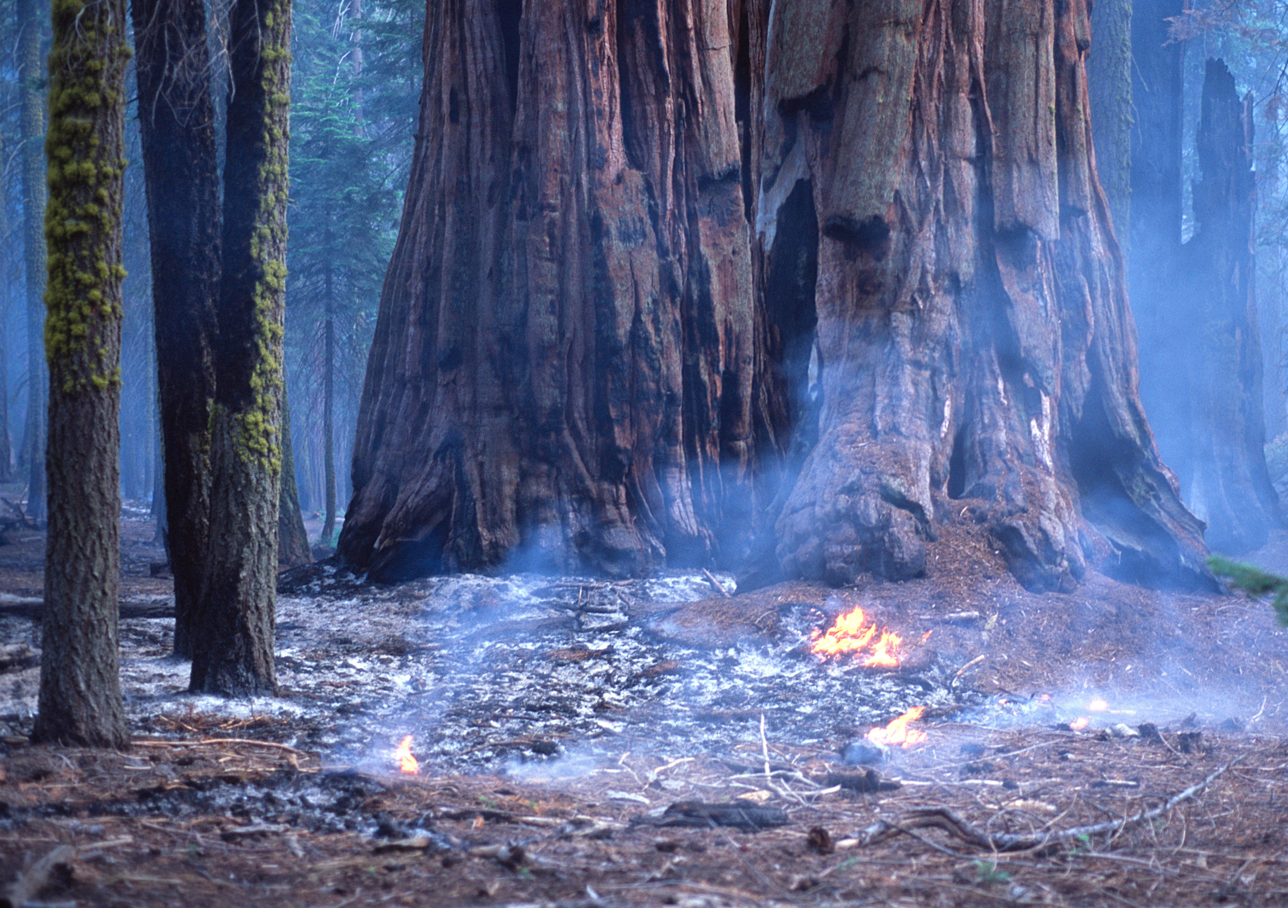
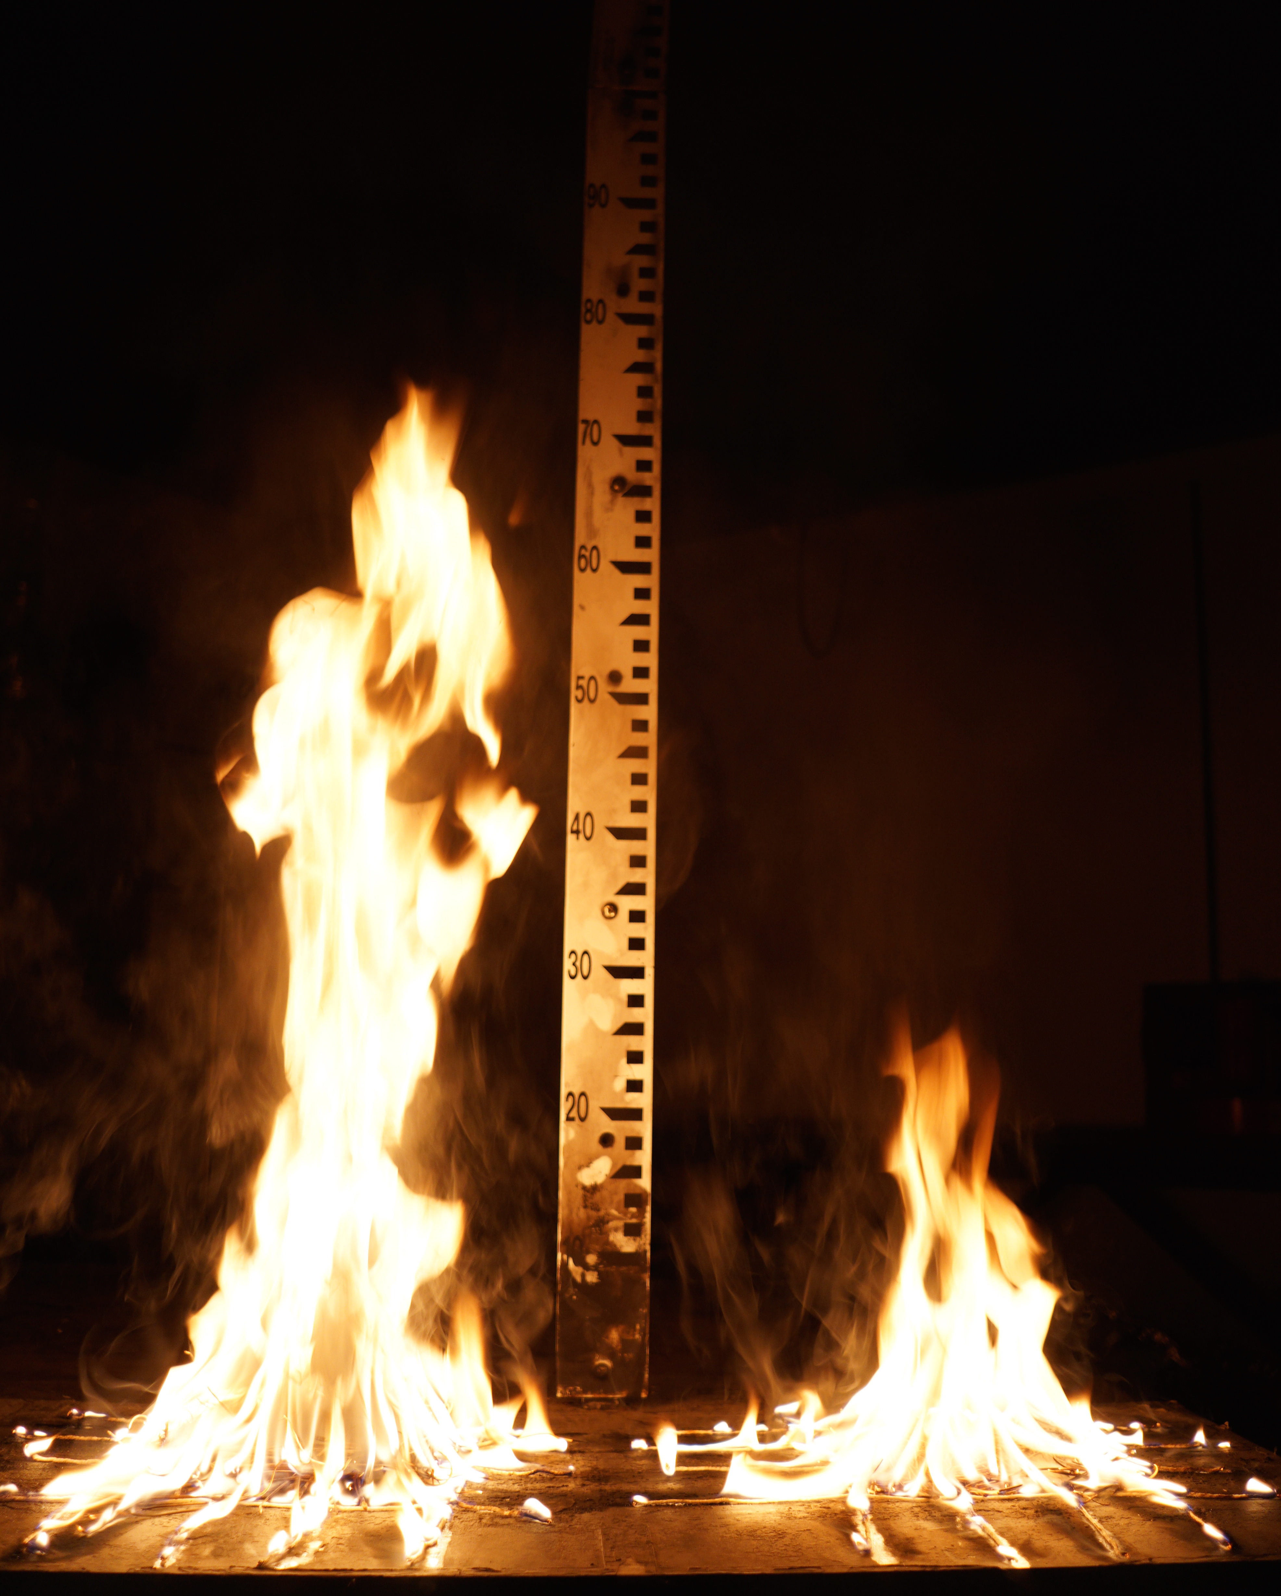
a
c
d
b

Slide 3
Caption:
Examples of fire resistance and flammability traits of different conifer species. (a): Pinus jeffreyi (left) and Pinus contorta (right) following the 2012 Reading Fire, Lassen National Park. The two species experienced similar fuel environments (fairly open-grown), with the Jeffrey pine surviving and the lodgepole pine dying. Note the lower profile of branches on Pinus contorta, indicating a lesser degree of self-pruning. (b): example of litter flammability differences in Pinus jeffreyi (left) and Pinus contorta (right), with Pinus jeffreyi having greater flame heights and shorter flame durations than Pinus contorta for a given mass of fuel (Table 1). (c): the North American conifer with the thickest bark, Sequoiadendron giganteum, during a prescribed fire in Sequoia National Park, California. (d): Morgan feel free to add a picture or send me several candidates.
Photo credits: (a): Jens Stevens, (b): Jeffrey Kane, (c): Dylan Schwilk, (d): J. Morgan Varner

